Slide 1
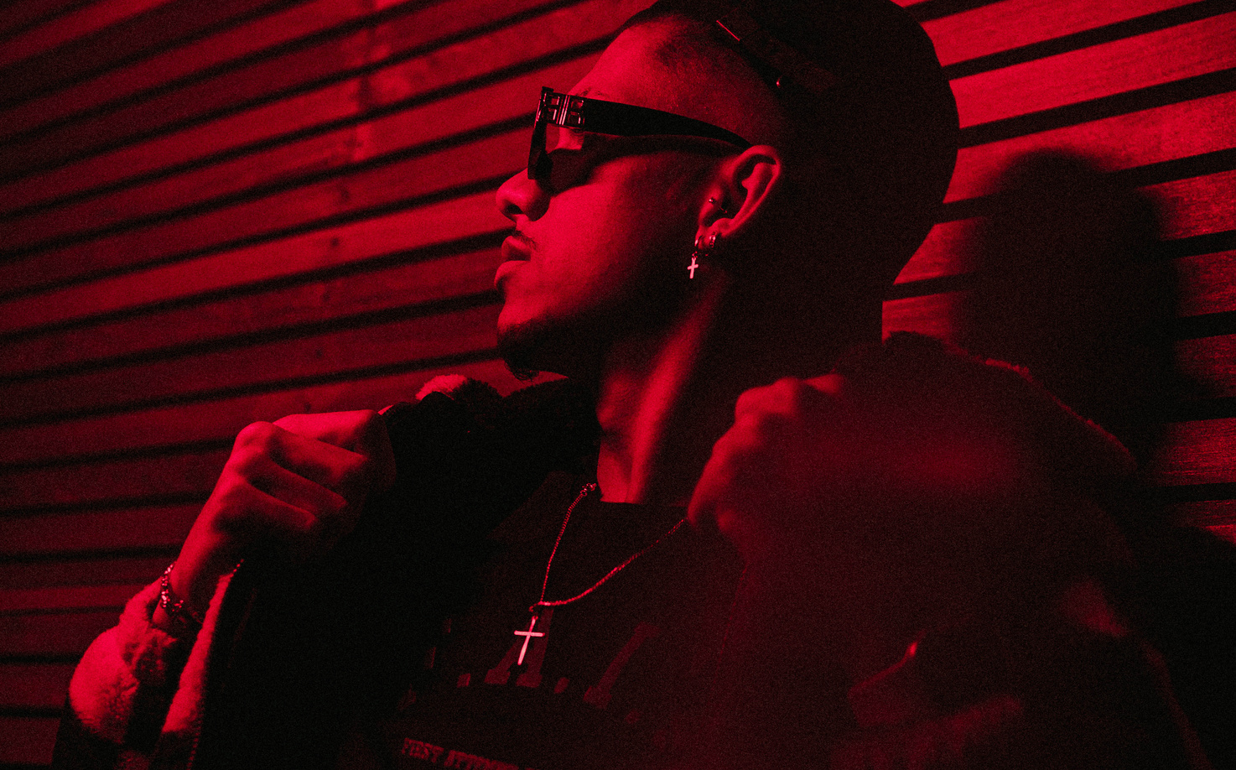
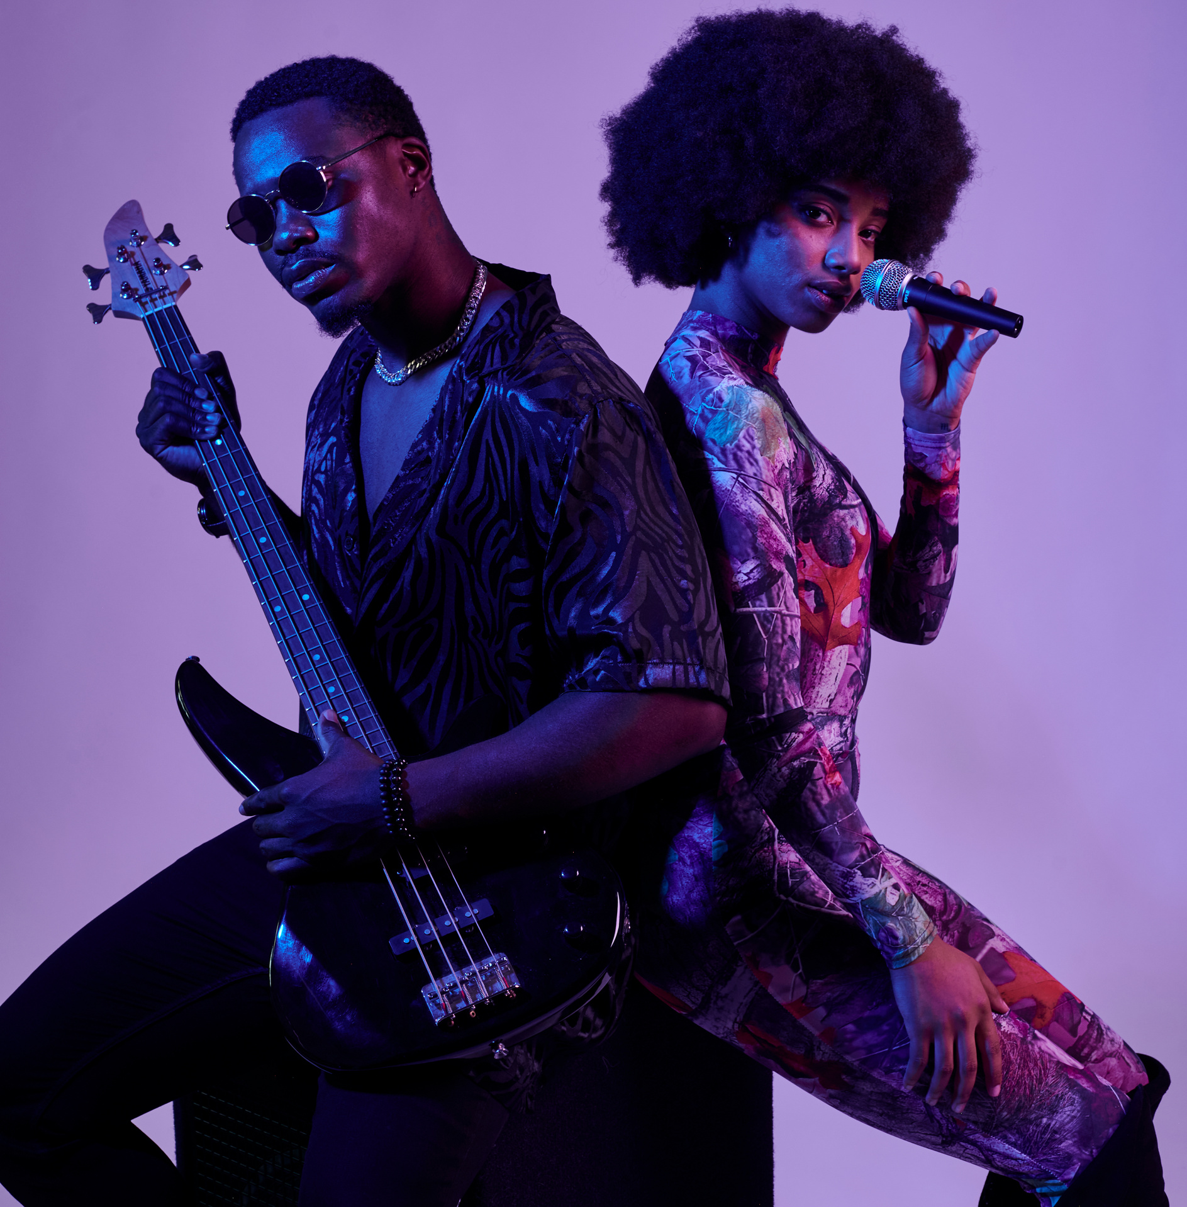

SPOTIFY
CLONE
NEXT
CHLOY COSTA 2447116
PRANAB RAI 2447137
SHANTANU DAS 2447151

Slide 2





PROJECT
OVERVIEW
Objective:
Create a music streaming application similar to Spotify.
Features:
Music streaming
Playlist management.
Advertisement free

Slide 3
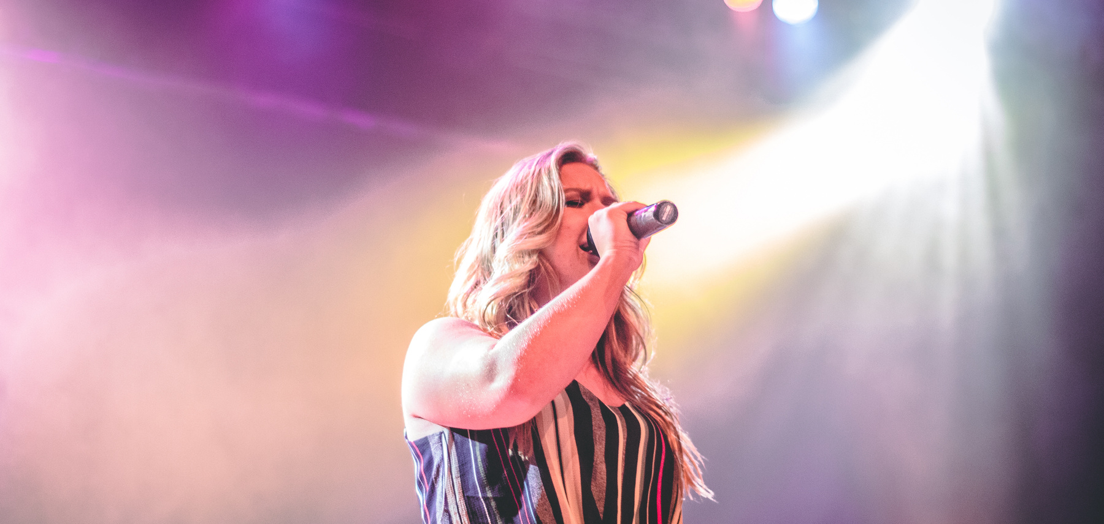
STACK
MERN
What is the MERN Stack?
MongoDB: A NoSQL database.
Express.js: A web application framework for Node.js.
React: A front-end JavaScript library for building user interfaces.
Node.js: A JavaScript runtime built on Chrome's V8 JavaScript engine.

Slide 4

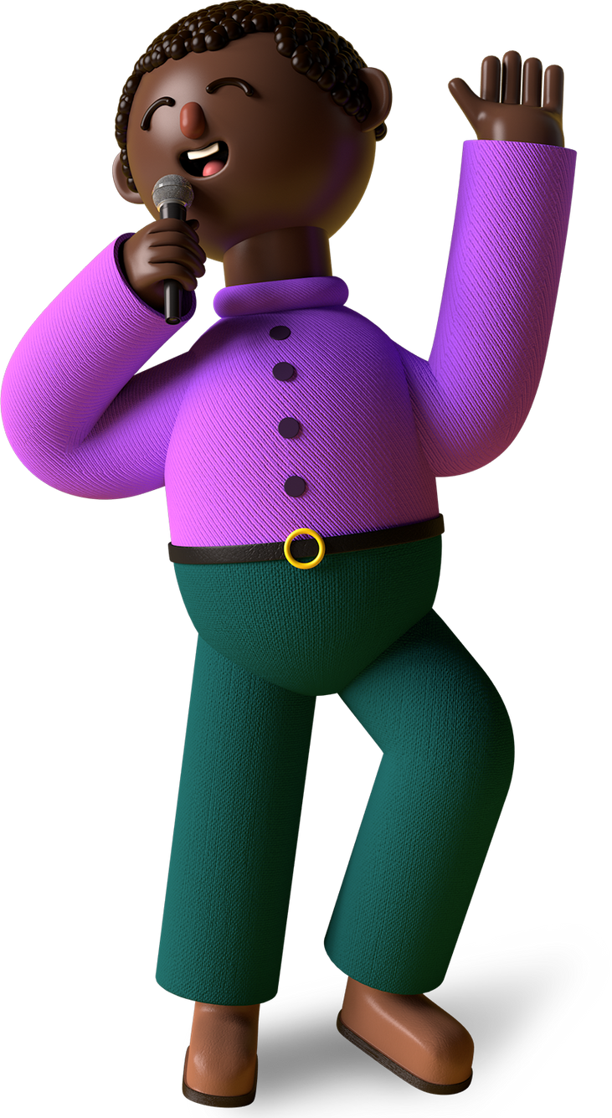

TECHNOLOGY
STACK
Backend:
Node.js with Express.js
MongoDB for database management
Cloudinary for image and media file upload
Frontend:
React for building the user interface

Slide 5
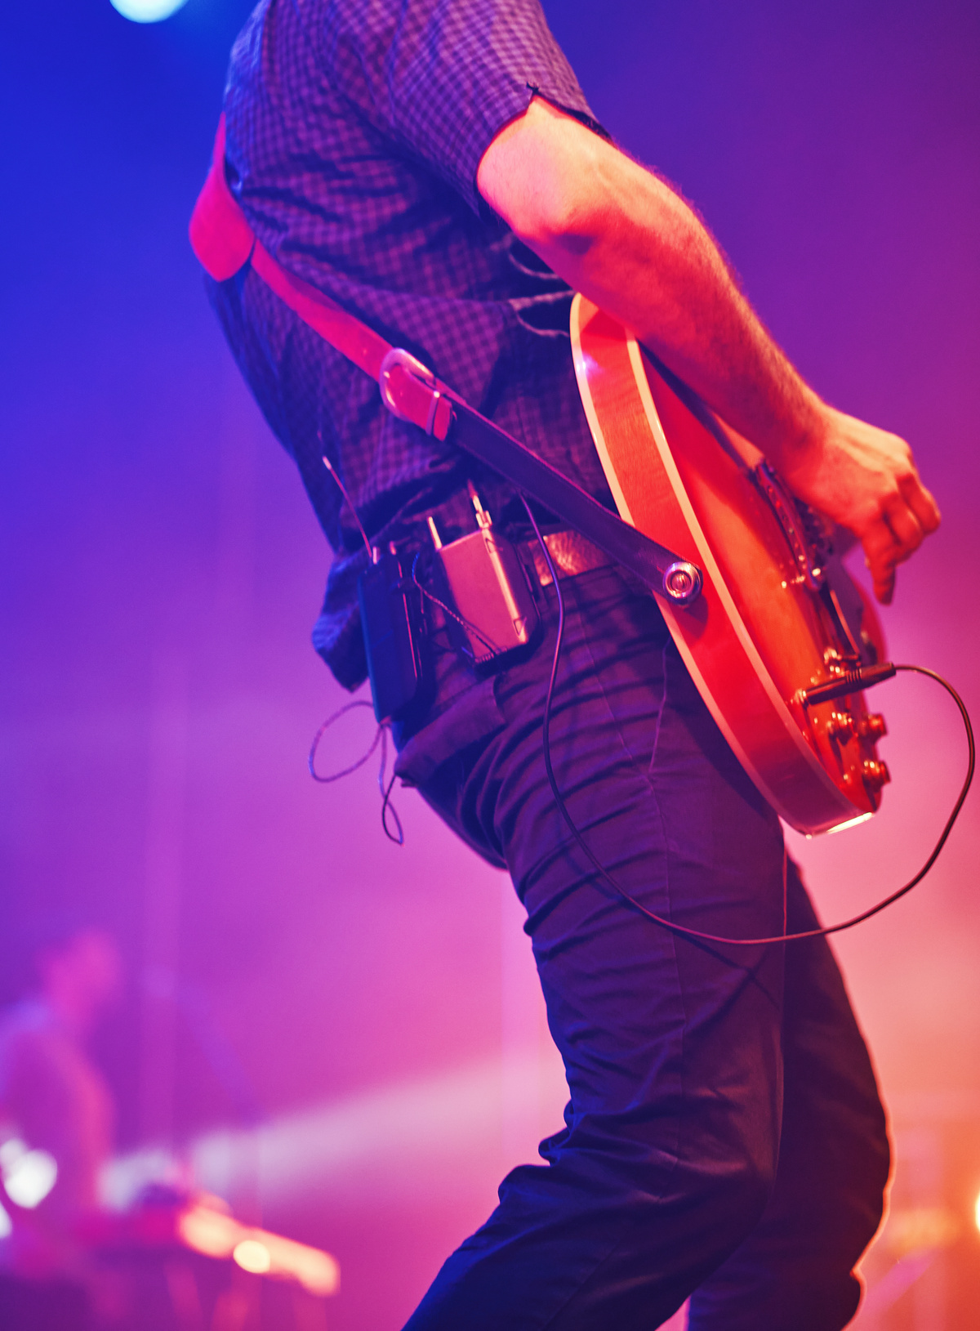
Collections:
Songs: Stores songs in cloudinary and file locations in mongodb.
Playlists: Stores albums in a similary manner.
DATABASE SCHEMA
OF THE MONTH

Slide 6

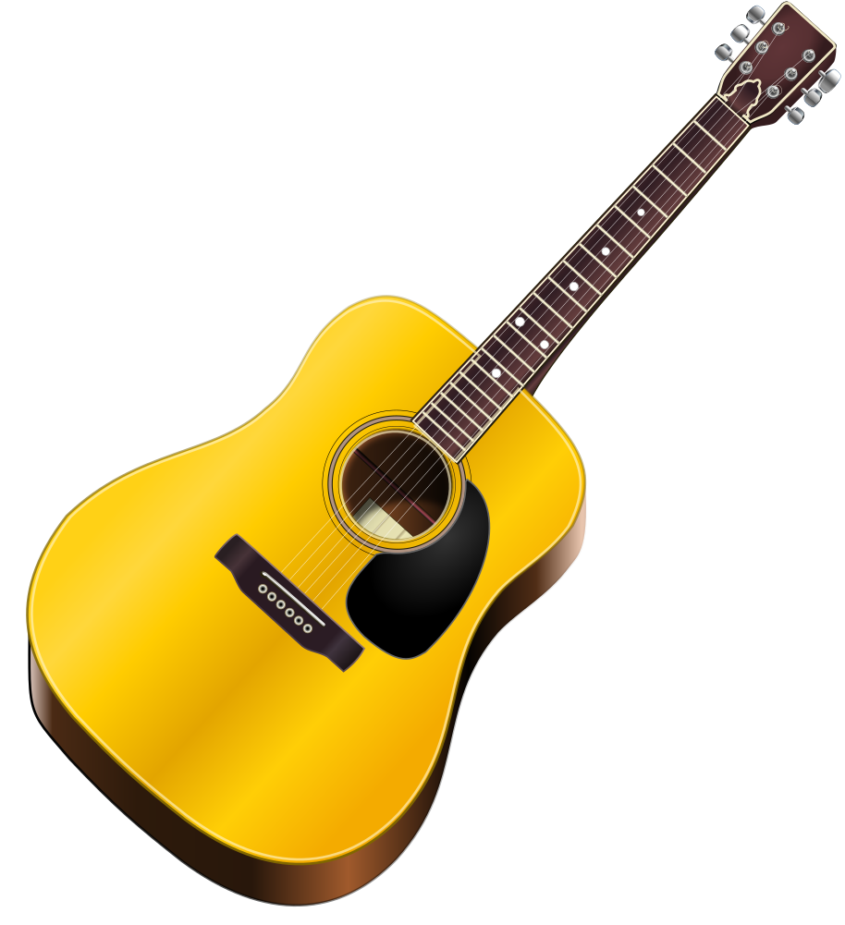

Frontend
COMPONENTS
React Components:
Navigation bar
Music player interface
Immersive interface
Playlist
Sidebar
Responsive

Slide 7
BACKEND
COMPONENTS
Express js Framework: A node js framework for features
Mongodb Database: Used for storing album and music data
Cloudinary storage: Used for storing album/ song covers and music mp3's
Multer: Used for uploading album/songs
Controllers: For adding, listing deleting albums/songs
API routes: Endpoints

Slide 8

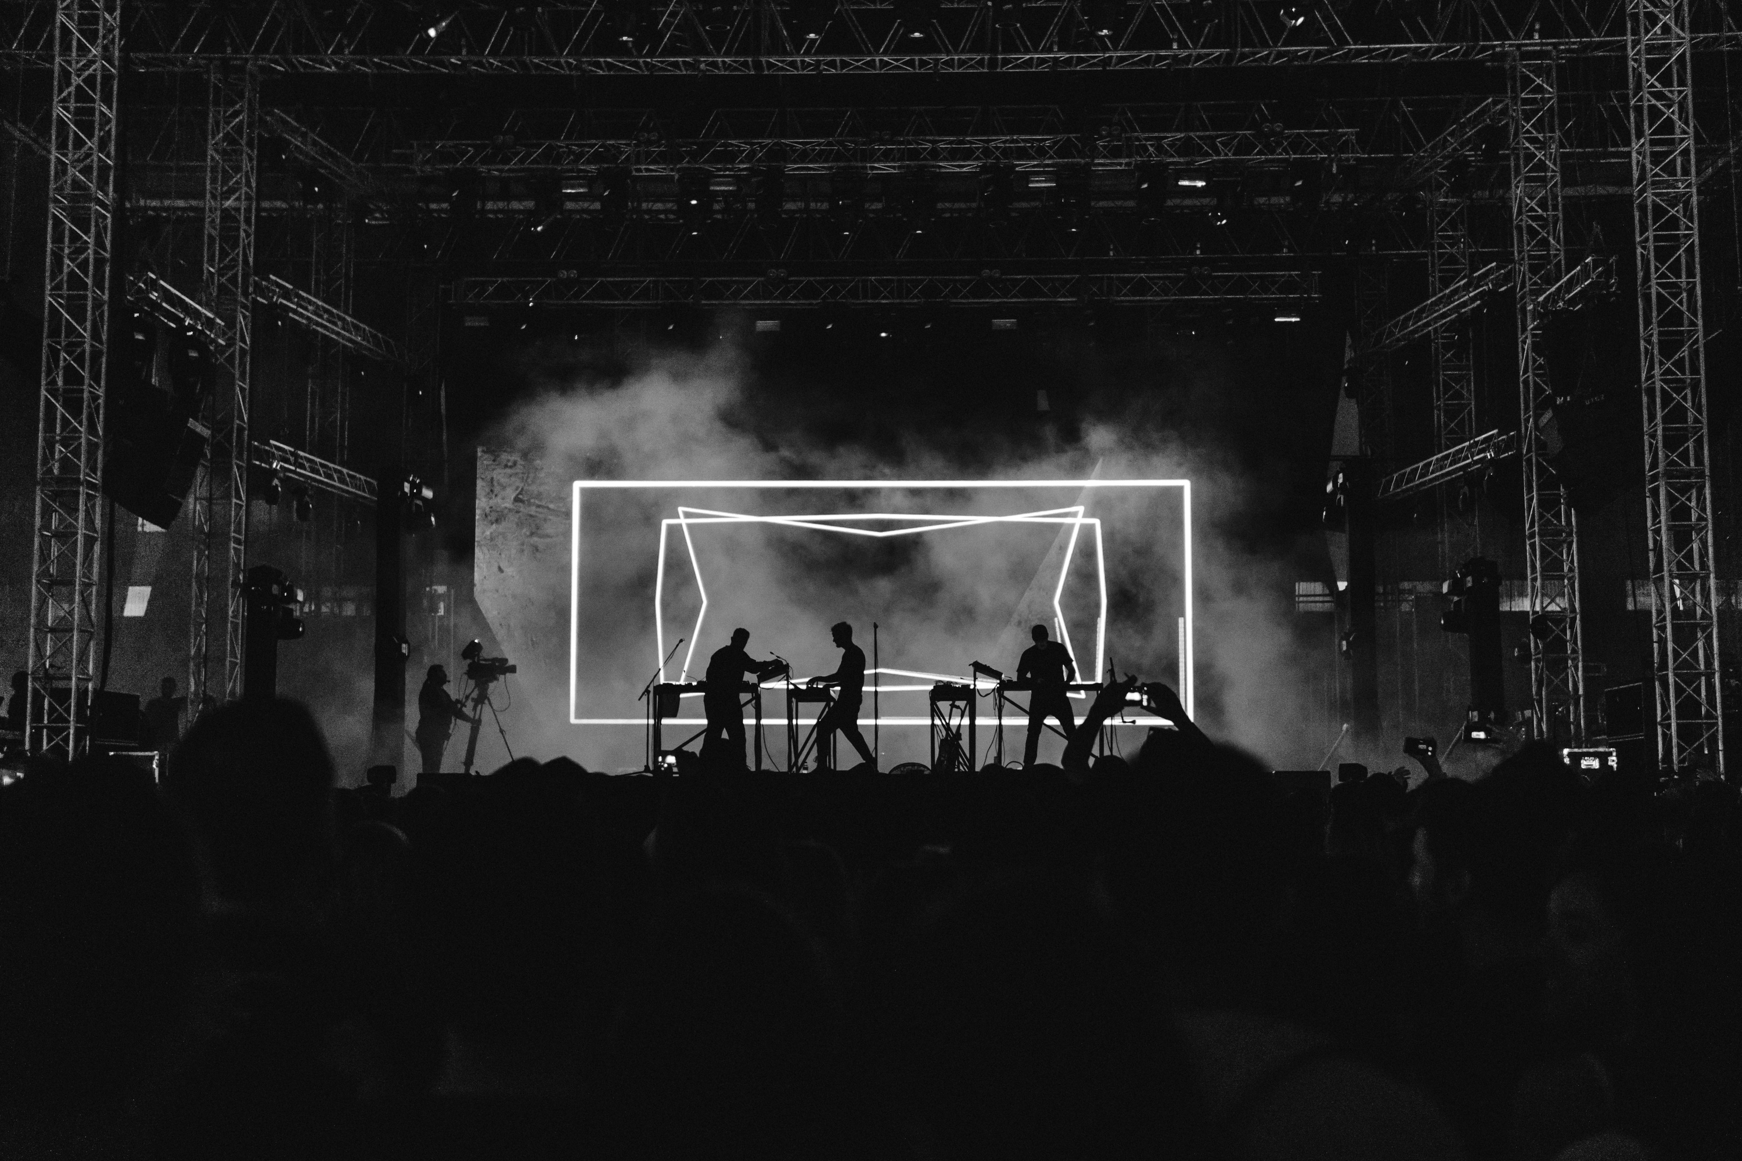
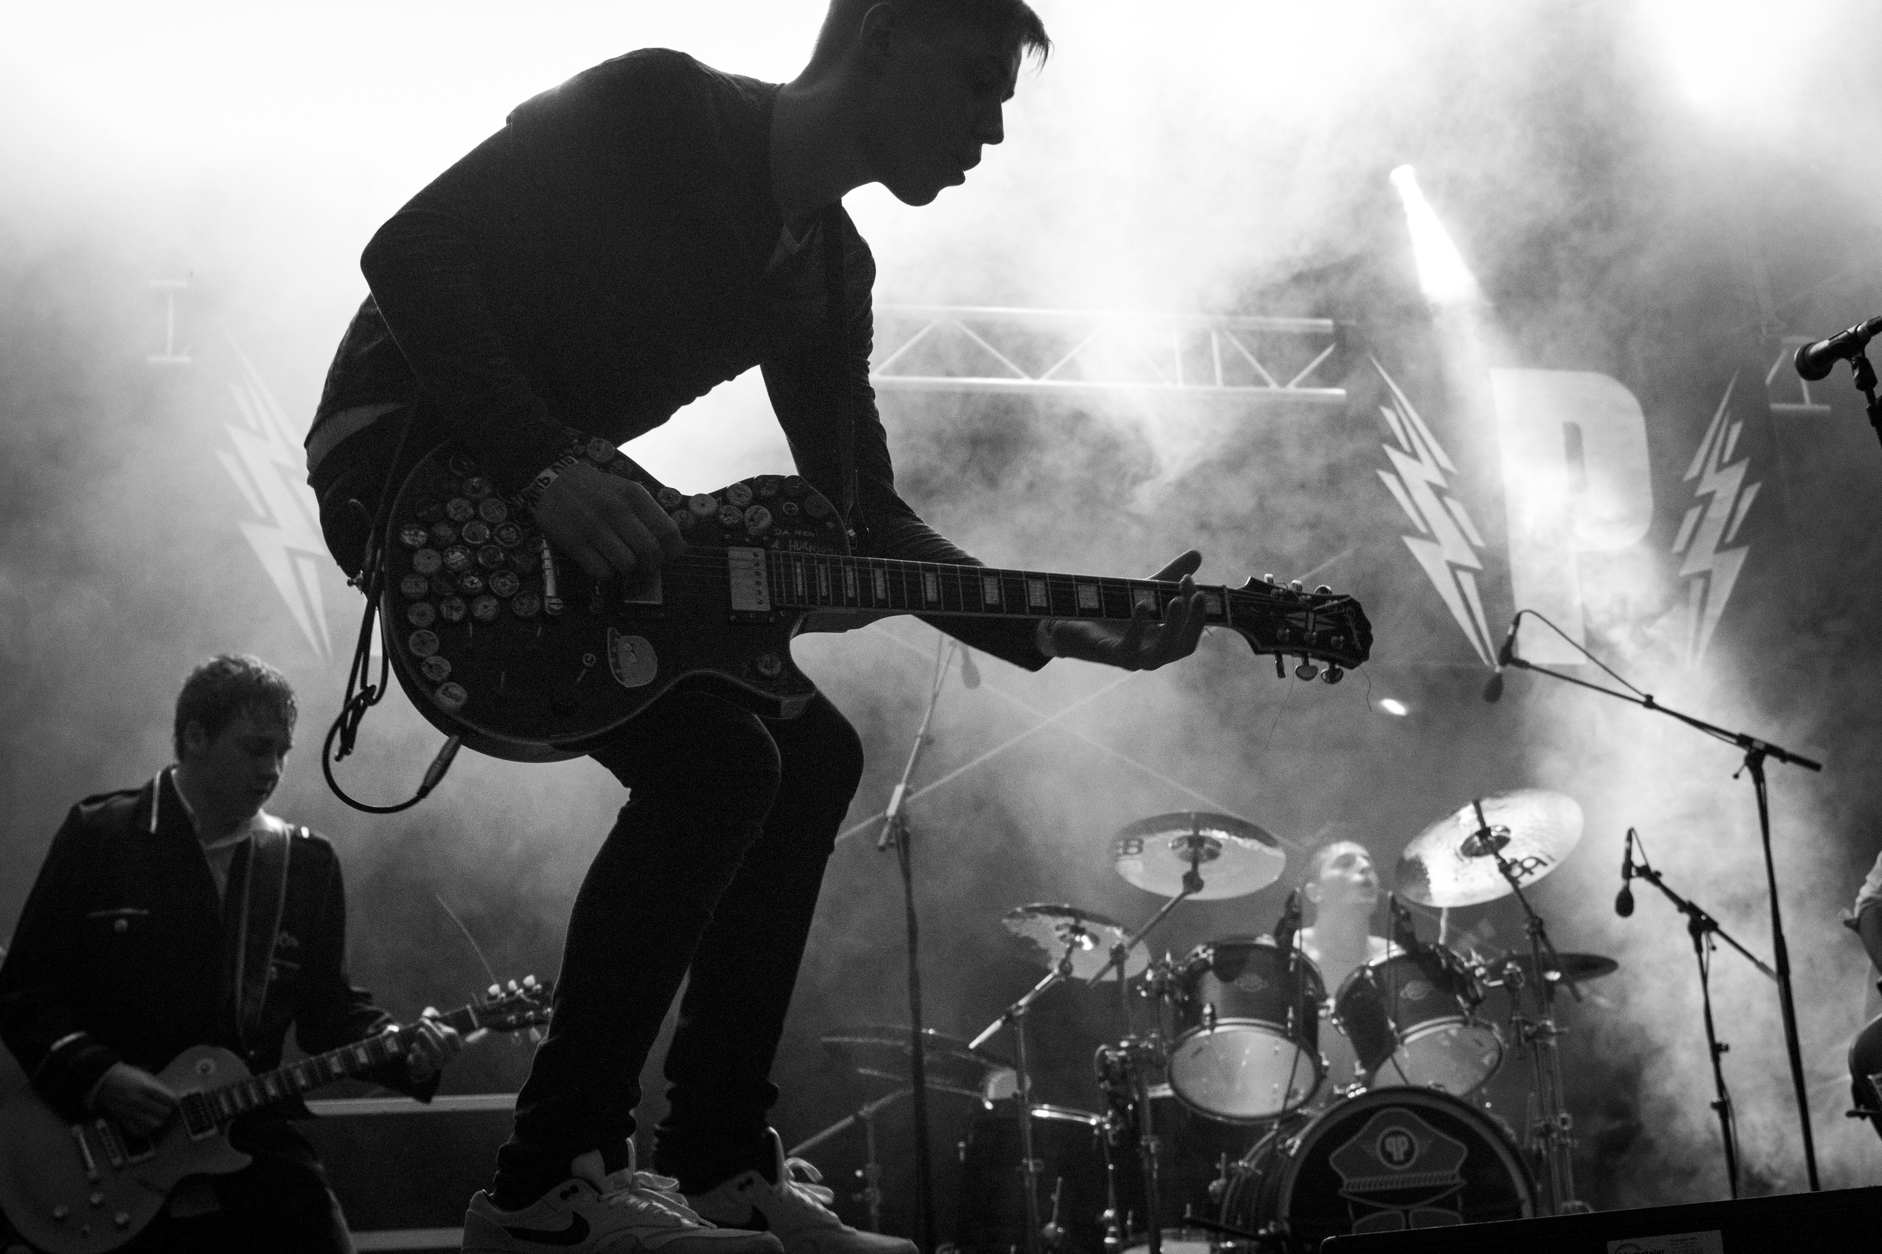
ADMIN
PANEL
Add Songs: The admin has the authority to add new song for the user
List Songs: The admin can view all the songs been in the application and can remove them
Add Album: The admin can add new albums to the application so that its easy to categorize for the user to find their fav artists songs
List Album: The admin view all the albums and can customize their colours and also can delete them

Slide 9

Challenges
AND SOLUTIONS
1
Handling large media files and ensuring smooth streaming
3
Integrating backend and frontend
Optimizing database queries for fast search results
2

Slide 10

Conclusion
21TH SEPT, 2024
CHRIST UNIVERSITY, BANGALORE, INDIA
Summary of the project
It was a great learning experience and also its very nice to see our project running. Its muse to our ears to hear this.
Future Enhancements:
Social features like sharing playlists
Real-time collaborative playlists
Integration with more music APIs

Slide 11
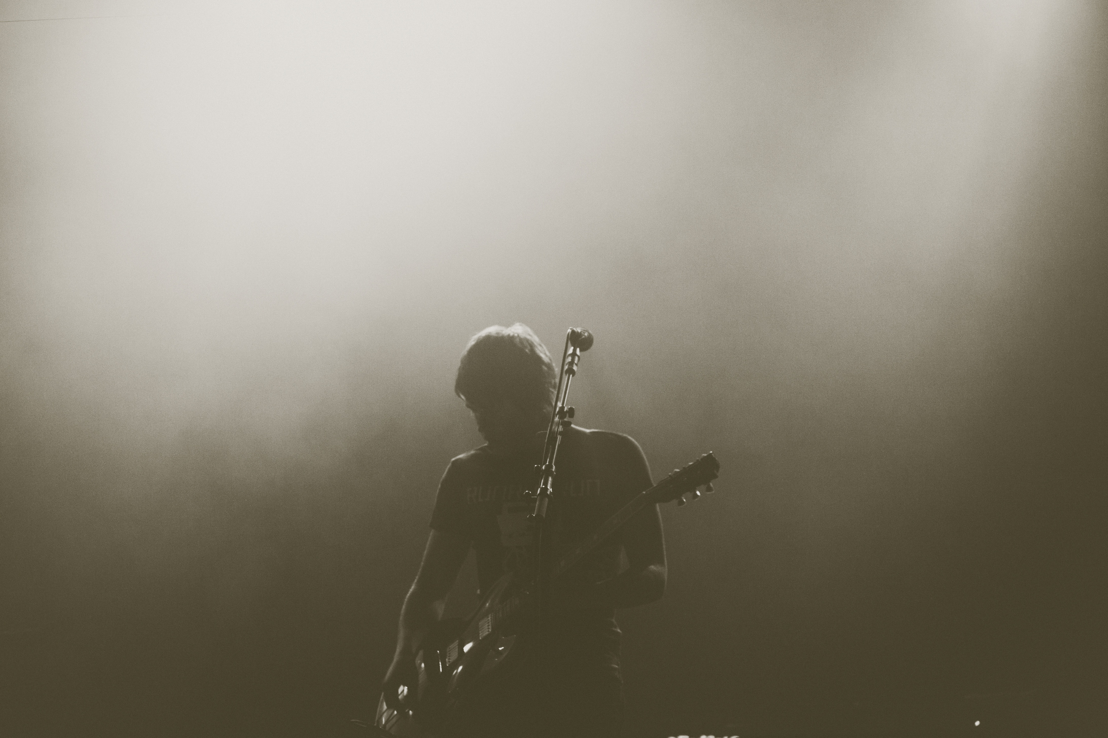
THANK'S FOR LISTENING
SPOTIFY CLONE

